Slide 1


ML-Driven Replication of Lunar Regolith Using
Earth-based Geological Oxide Mixtures for Sustainable Space Construction (REGOMIX)
Ayush Raj
Bushra Riaz
Zeynep Karakaş
Supervisers:
Dr. Melike Nur Önder
Prof. Dr. Mehmet Ali Gülgün

Slide 2
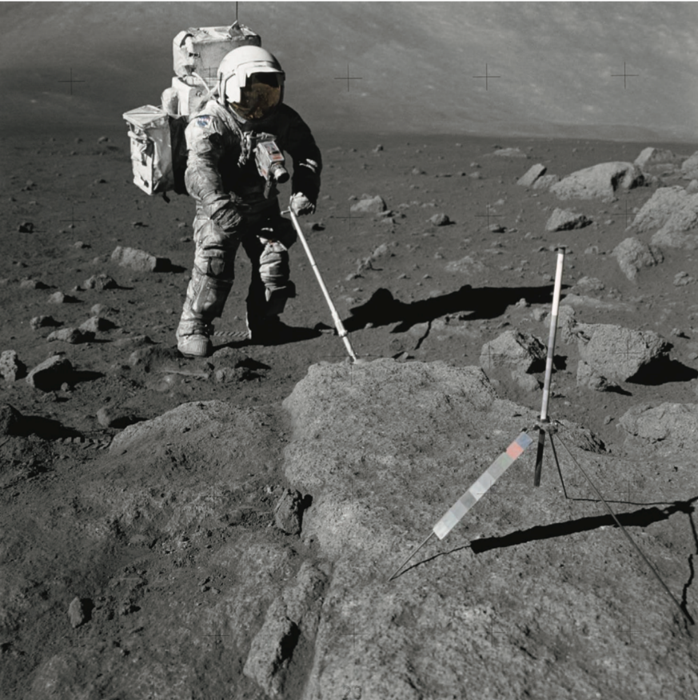
Aim of the Project
This project aims to develop improved simulants that match closely with the lunar regolith’s chemical and mineral composition.
Simulants are needed to test activities planned to be done on the Moon, such as construction, agriculture, and oxygen extraction on the Earth.
Weiss, P., et al, Adv. Mat. Tech. (2020)
Figure 1. Effect of lunar regolith on Apollo spacesuit.
2
2

Slide 3
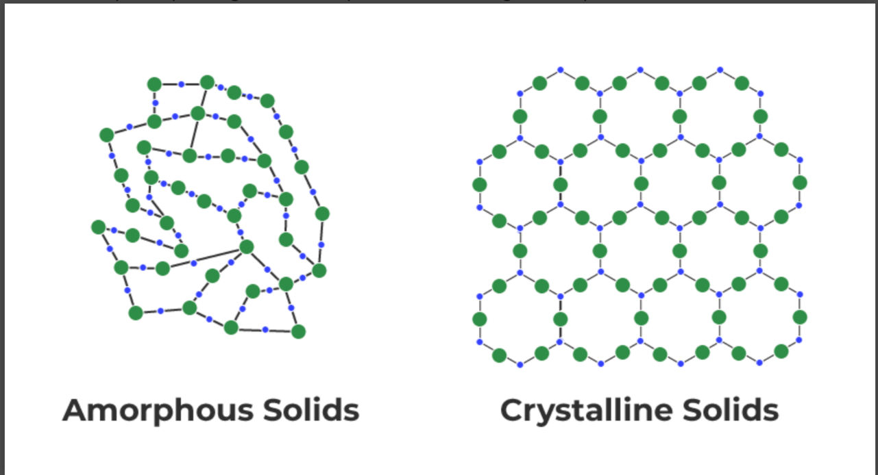
Introduction
Collected data on the crystalline and amorphous phases of lunar regolith
Applied machine learning to determine the optimal ratio of Earth-based materials for accurate lunar regolith simulation.
GeeksforGeeks. (2025, July 23)
Figure 2. Difference between crystalline and amorphous
3

Slide 4
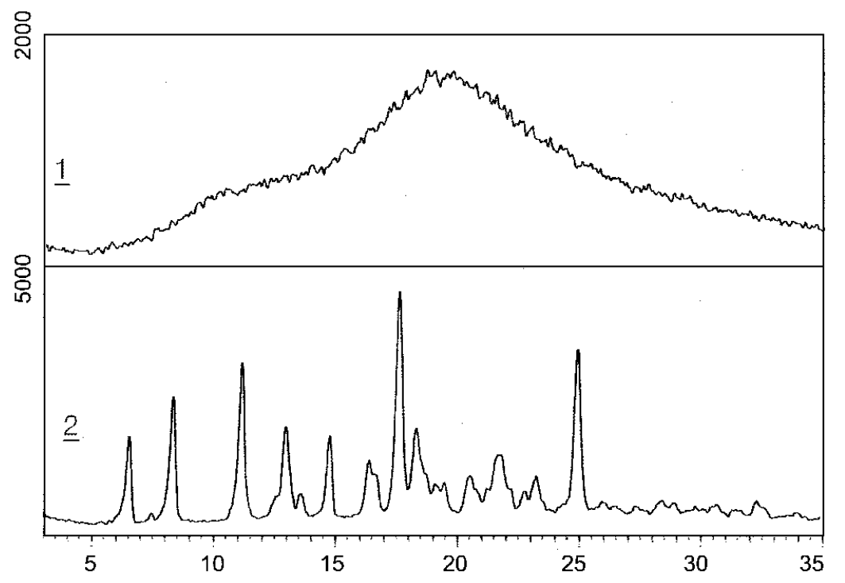
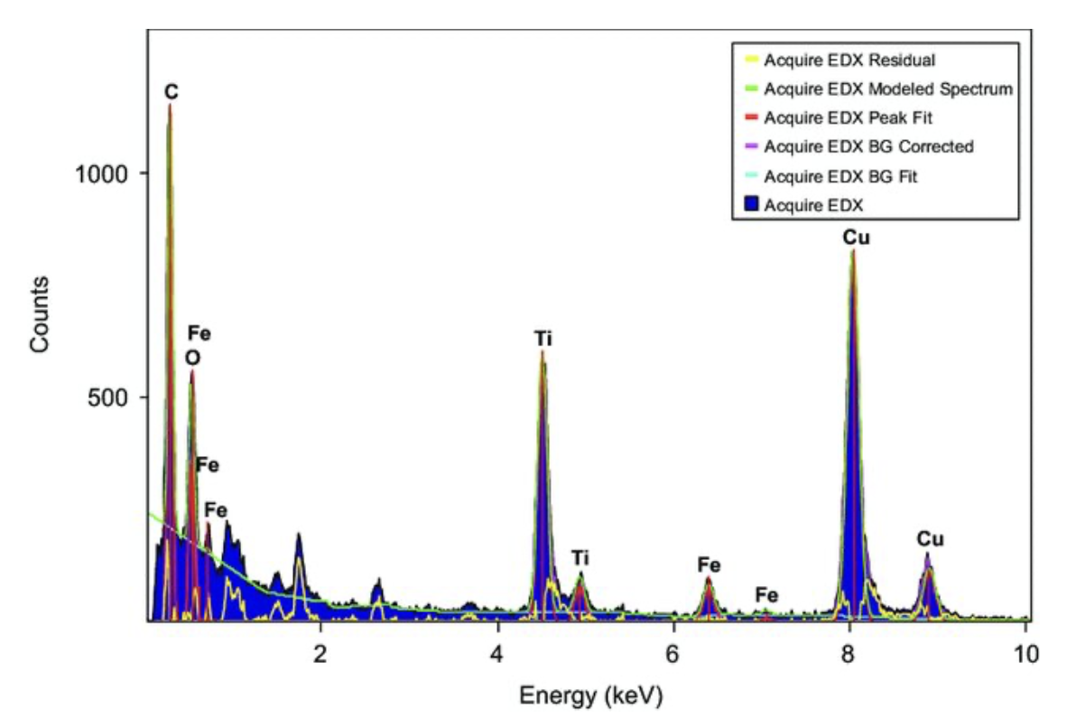
Overview
Mainly XRD and EDX results are used for determining the composition of lunar regolith.
XRD DATA
EDX DATA
XRD DATA
Kim, Y., & Kim, A., Bull.Korean Chem.Soc. (2002).
Yan, H., Zhao, T., Li, X., & Hun, C., Ceramics International . (2015).
Figure 3. Solid-state characterization of the HIV protease inhibitor.
Figure 4. Synthesis of Cu-doped nano-TiO₂ by detonation method
4

Slide 5
Literature Review
• Most studies use ML to analyze lunar surface properties.
• Focus is mainly on the crystalline phase due to easier detection.
• However, the amorphous–crystalline distribution affects mechanical
behavior.
• This aspect is often ignored, creating a key gap in current research.
5

Slide 6
Data Collection
DATA
LUNAR
APOLLO
CHANG’E
EARTH
TBG-1
LUNA
OTHERS
National Science Review
NASA.gov
Advances in Space Research
Acta Astronautica
Planetary and Space Science
International Journal of Mining Sciences and Technology
6

Slide 7
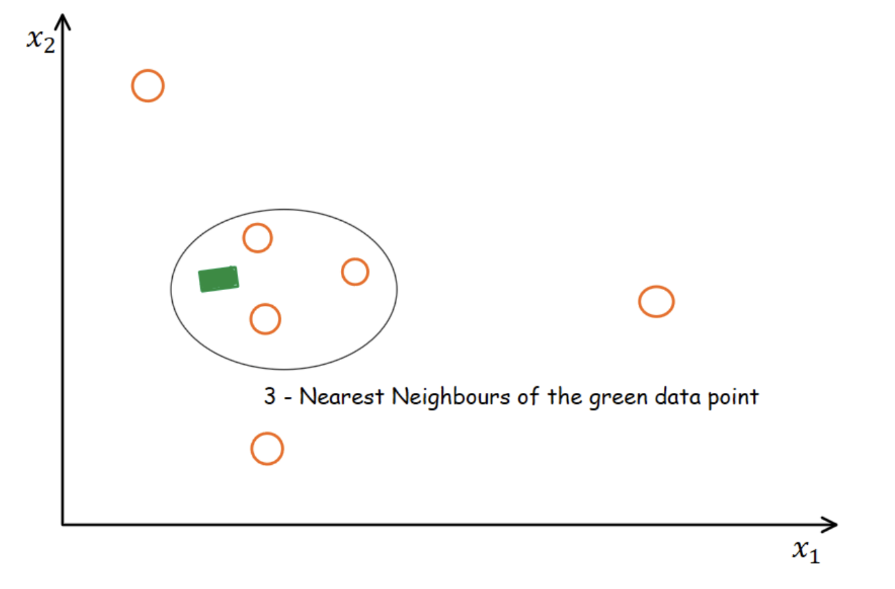
KNN Imputation
Find 4 nearest data points that have most similar features using the euclidean distance
Missing value is estimated using average of those data point values
KNN imputation used on Highland,Mare and Earth samples seperately.
Accuracy of KNN imputation : 85%-90%
Kaushikrch., Analitics Vidhya, (2024, October 15).
Figure 5. KNN Imputer
7

Slide 8
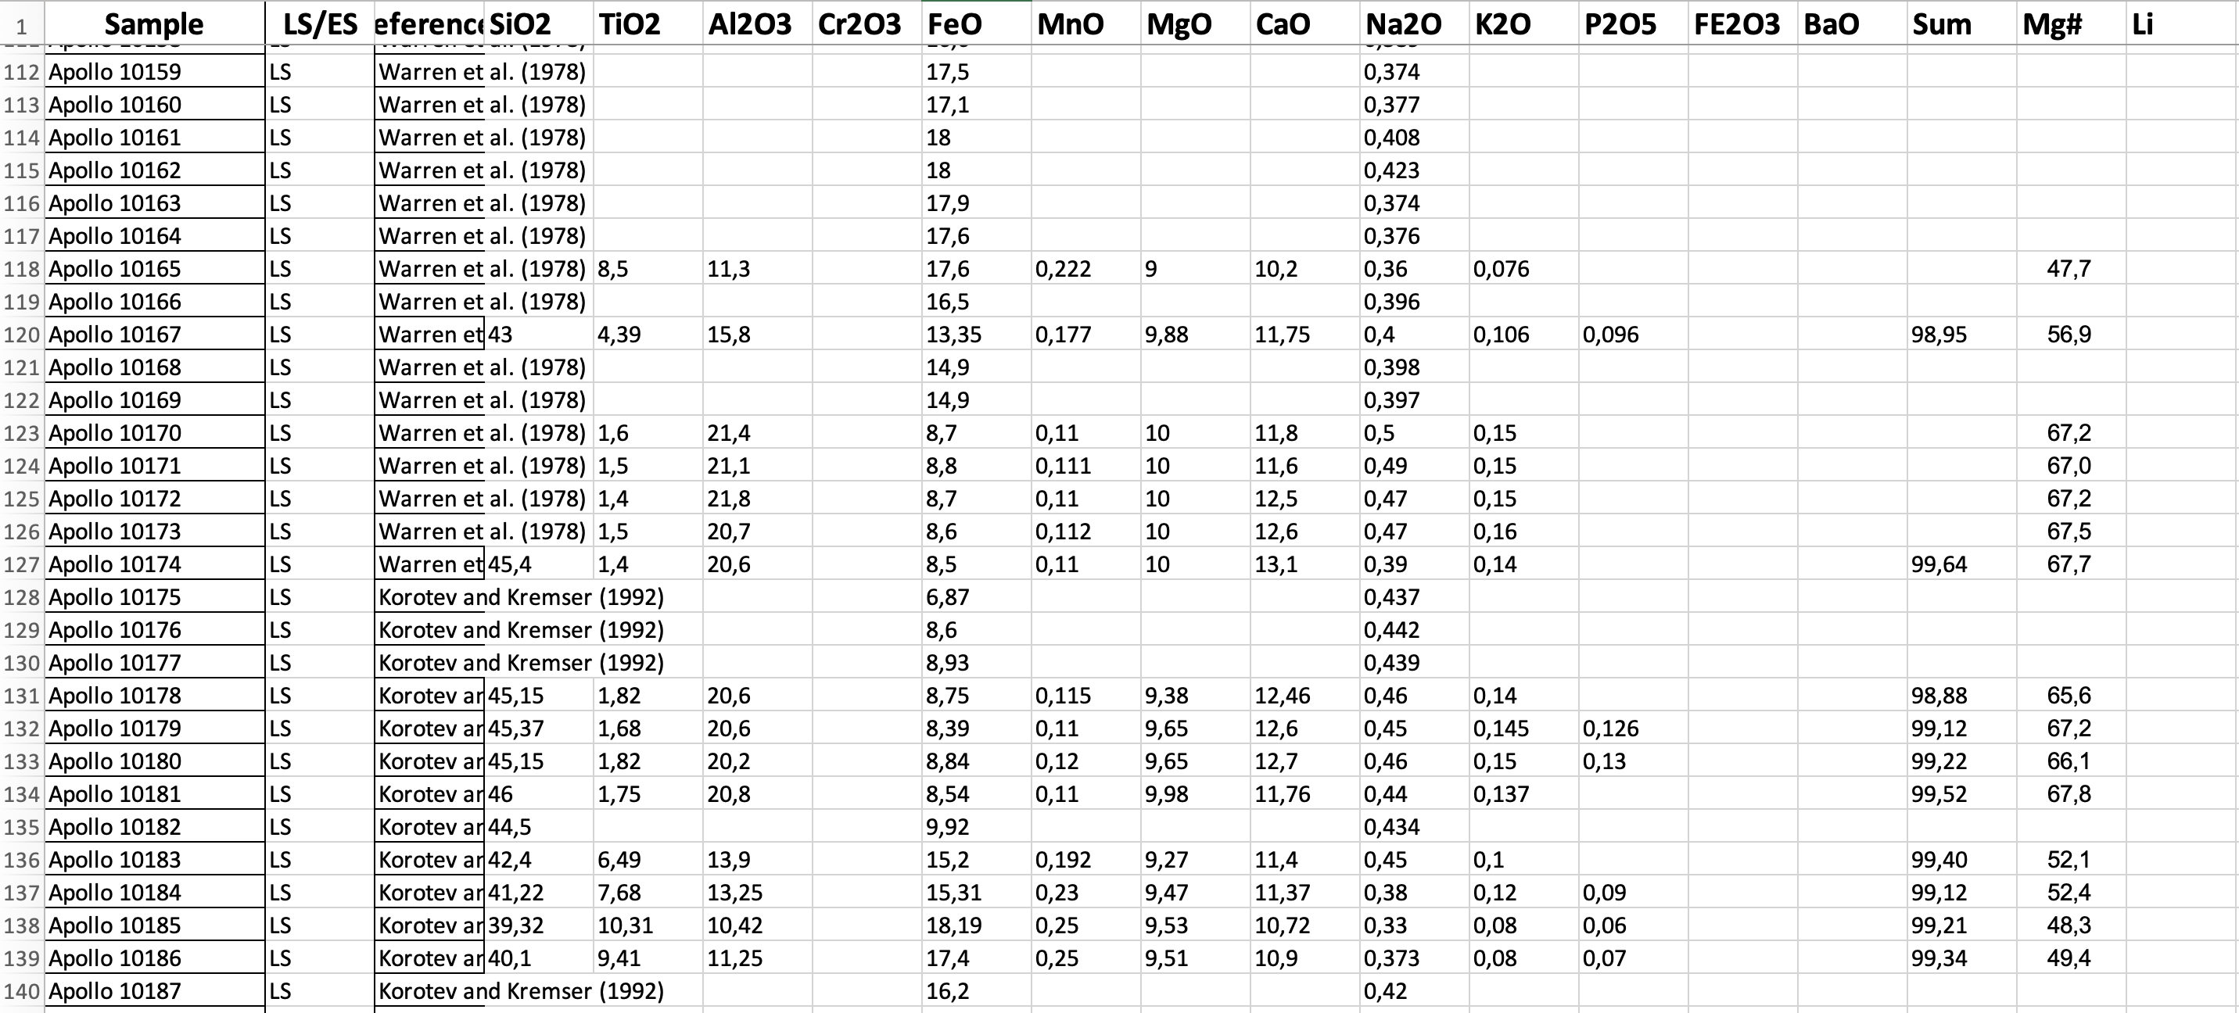
Before Data Imputation
COLUMN NUMBER: 100 ROW NUMBER:253
Figure 6: XRD and EDX dataset
8

Slide 9
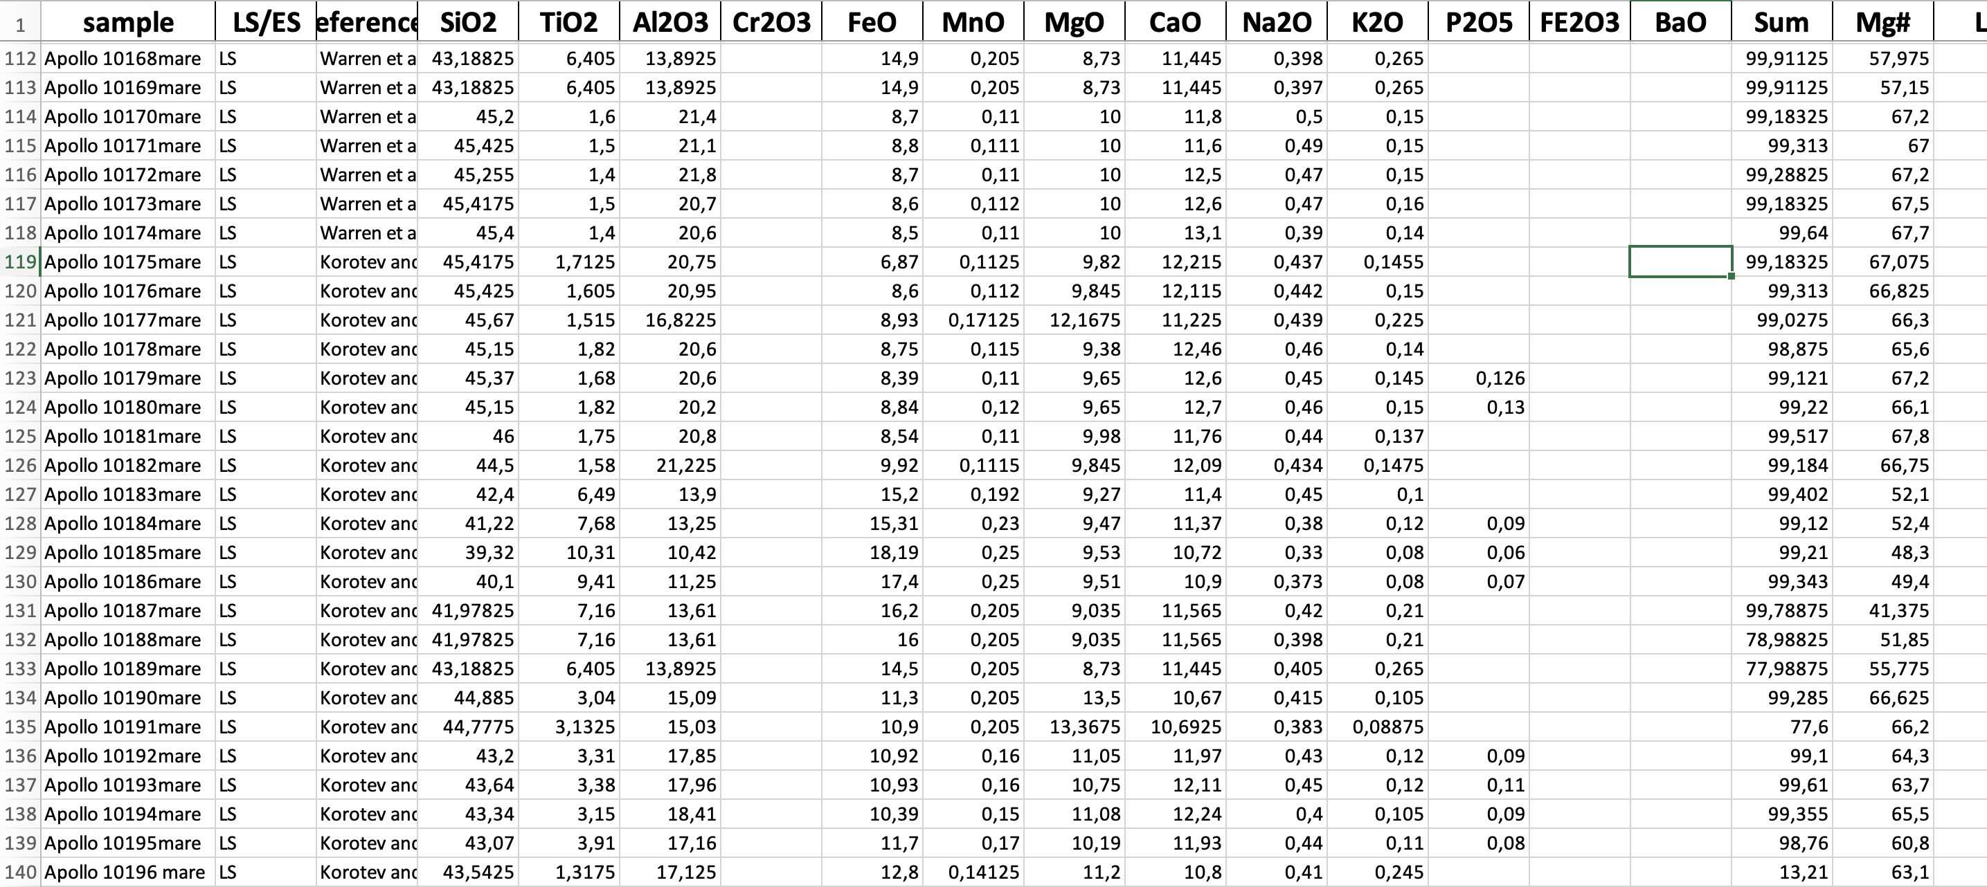
After Data Imputation
COLUMN NUMBER: 100 ROW NUMBER:252
Figure 7. Cleaned XRD and EDX dataset
9

Slide 10
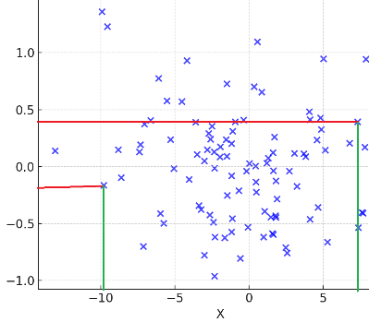

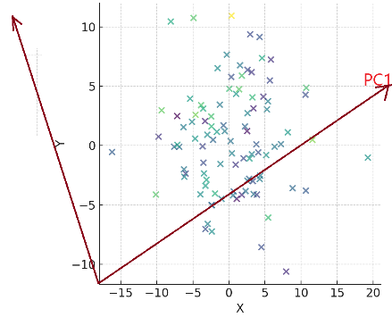
PCA
Normal Distributed Graph
Why PCA?
Decrease dimensionality of the dataset while preserving variance.
Suitable for noisy datasets with missing values.
Ensuring efficient and accelerated algorithmic performance.
D
D‘
Figure 9. Variance of coordintates
Figure 8. TV camera during a football match in a stadium
AndreyPopov., iStock (n.d.).
Figure 10. Variance on PCA Axis
10

Slide 11
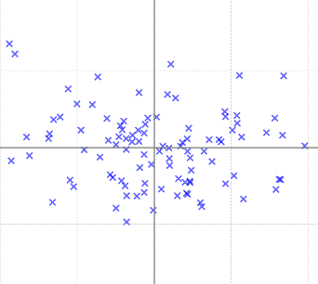
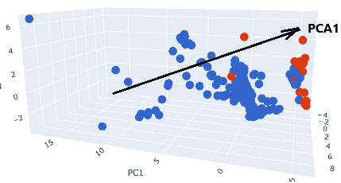
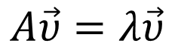
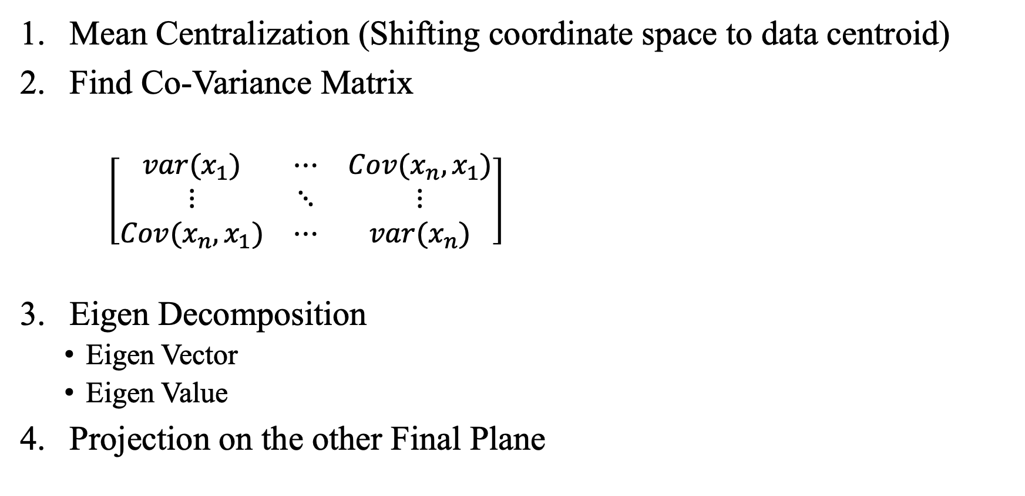
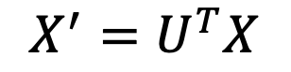
How PCA Works?
Mean Centralization (Shifting coordinate space to data centroid)
Find Co-Variance Matrix
$\left[\begin{matrix}var(x_{1}) & ⋯ & Cov(x_{n},x_{1}) \\ ⋮ & ⋱ & ⋮ \\ Cov(x_{n},x_{1}) & ⋯ & var(x_{n})\end{matrix}\right]$
Eigen Decomposition
Eigen Vector
Eigen Value
Projection on the other Final Plane
Figure 11. Mean Centralization
$$A\vec{υ}=λ\vec{υ}$$
$$X^{′}=U^{T}X$$
Figure 12. Projection of point in final PCA plane
11

Slide 12
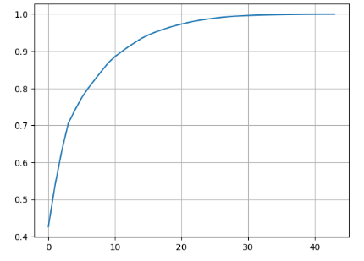
Analysis
Variance explained by each principal component.
[0.45, 0.30, 0.15, 0.07, 0.03]
PC1 explains 45% of the total variance
PC2 explains 30% of the total variance
PC3 explains 15% of the total variance
Cumulative sum of the variance ratio.
[0.45, 0.30, 0.15, 0.07]→ [0.45, 0.75, 0.90, 0.97]
How many PCs do need to keep more than 90% of the information?
Percentage vs Number of components
Figure 13. Cumulative sum of the variance ratio for different PCAs
12

Slide 13
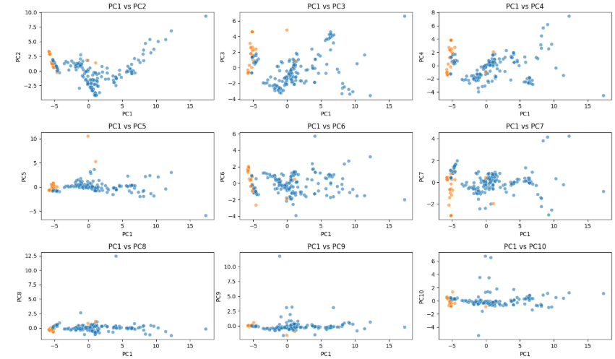
Results
Results of PCA
Figure 14. Bivariate Analysis of PCA1 with other PCAs
13

Slide 14
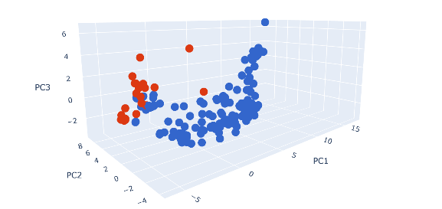
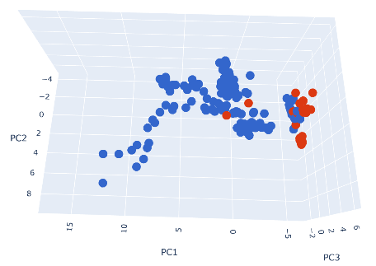
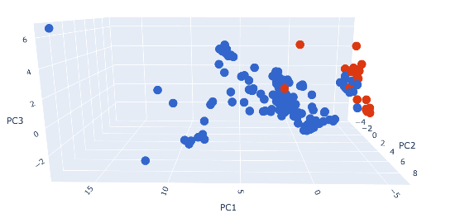
Perspective Views of 3D PCA Plot (PCA1,2 and 3)
Axial view
Top view
Figure 15. 3D Scatter plot of PCA 1,2 and 3
Horizontal Side view
Figure 16. 3D Scatter plot of PCA 1,2 and 3
Figure 17. 3D Scatter plot of PCA 1,2 and 3
14

Slide 15
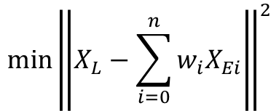
Ongoing Research: Optimization
The fractions is crucial to closely mimic the composition and behavior of lunar-like materials using Earth-based analogs.
How Optimization work
Convex Combination Problem
Minimize the Euclidean distance
$$X_{l}=a_{1}X_{e1}+a_{2}X_{e2}+…+{a_{n}X}_{en}$$
$$\min{{\left\|\left.X_{L}−\sum_{i=0}^{n}{w_{i}X_{Ei}}\right\|\right.}^{2}}$$
$$Y_{l}=a_{1}Y_{e1}+a_{2}Y_{e2}+…+{a_{n}Y}_{en}$$
15

Slide 16
Future Works
Enhancing mechanical similarity by matching particle size and microstructure.
Initiate algae and microbial cultivation on replicated soil to explore life-support applications and test the machines for mining and construction..
Continue working with universities on biology and habitat-related research.
16

Slide 17

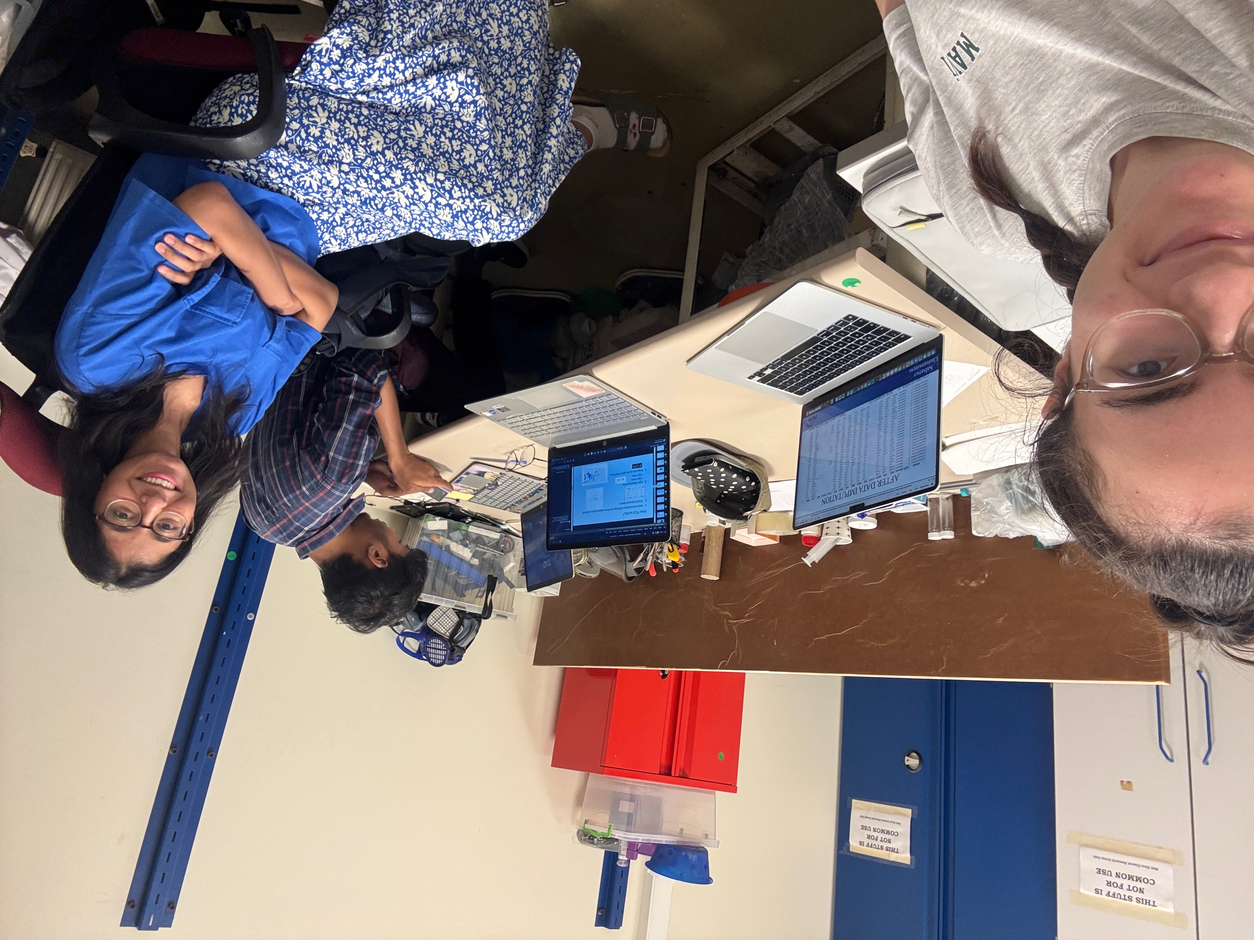
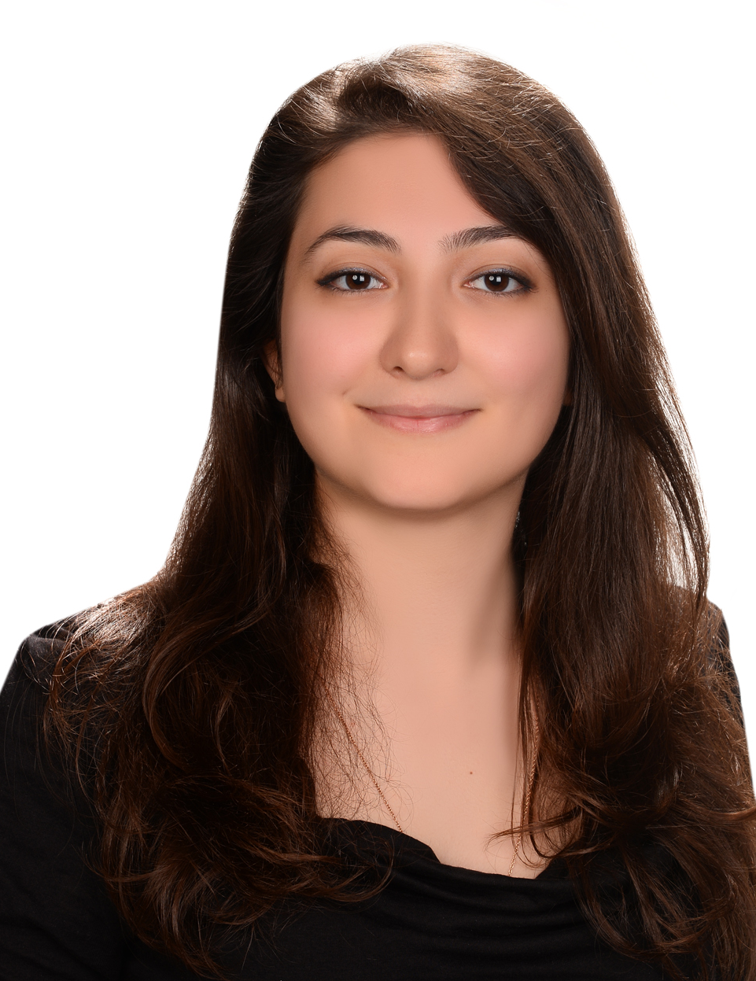
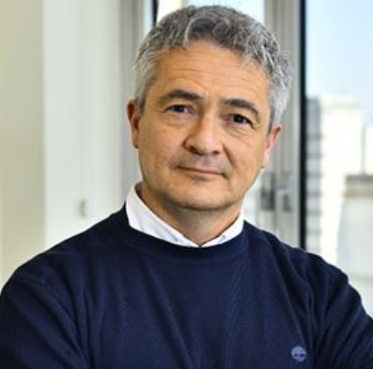
17
17

